Slide 1
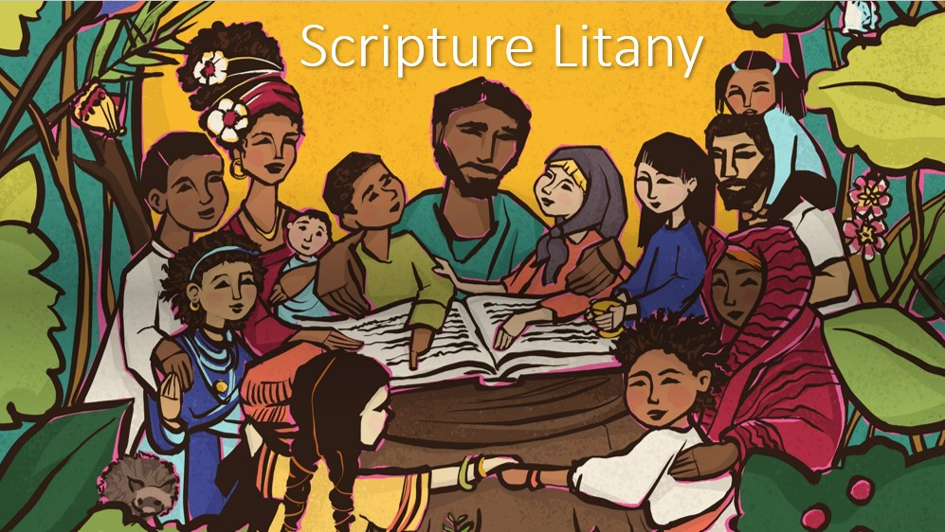

Slide 2
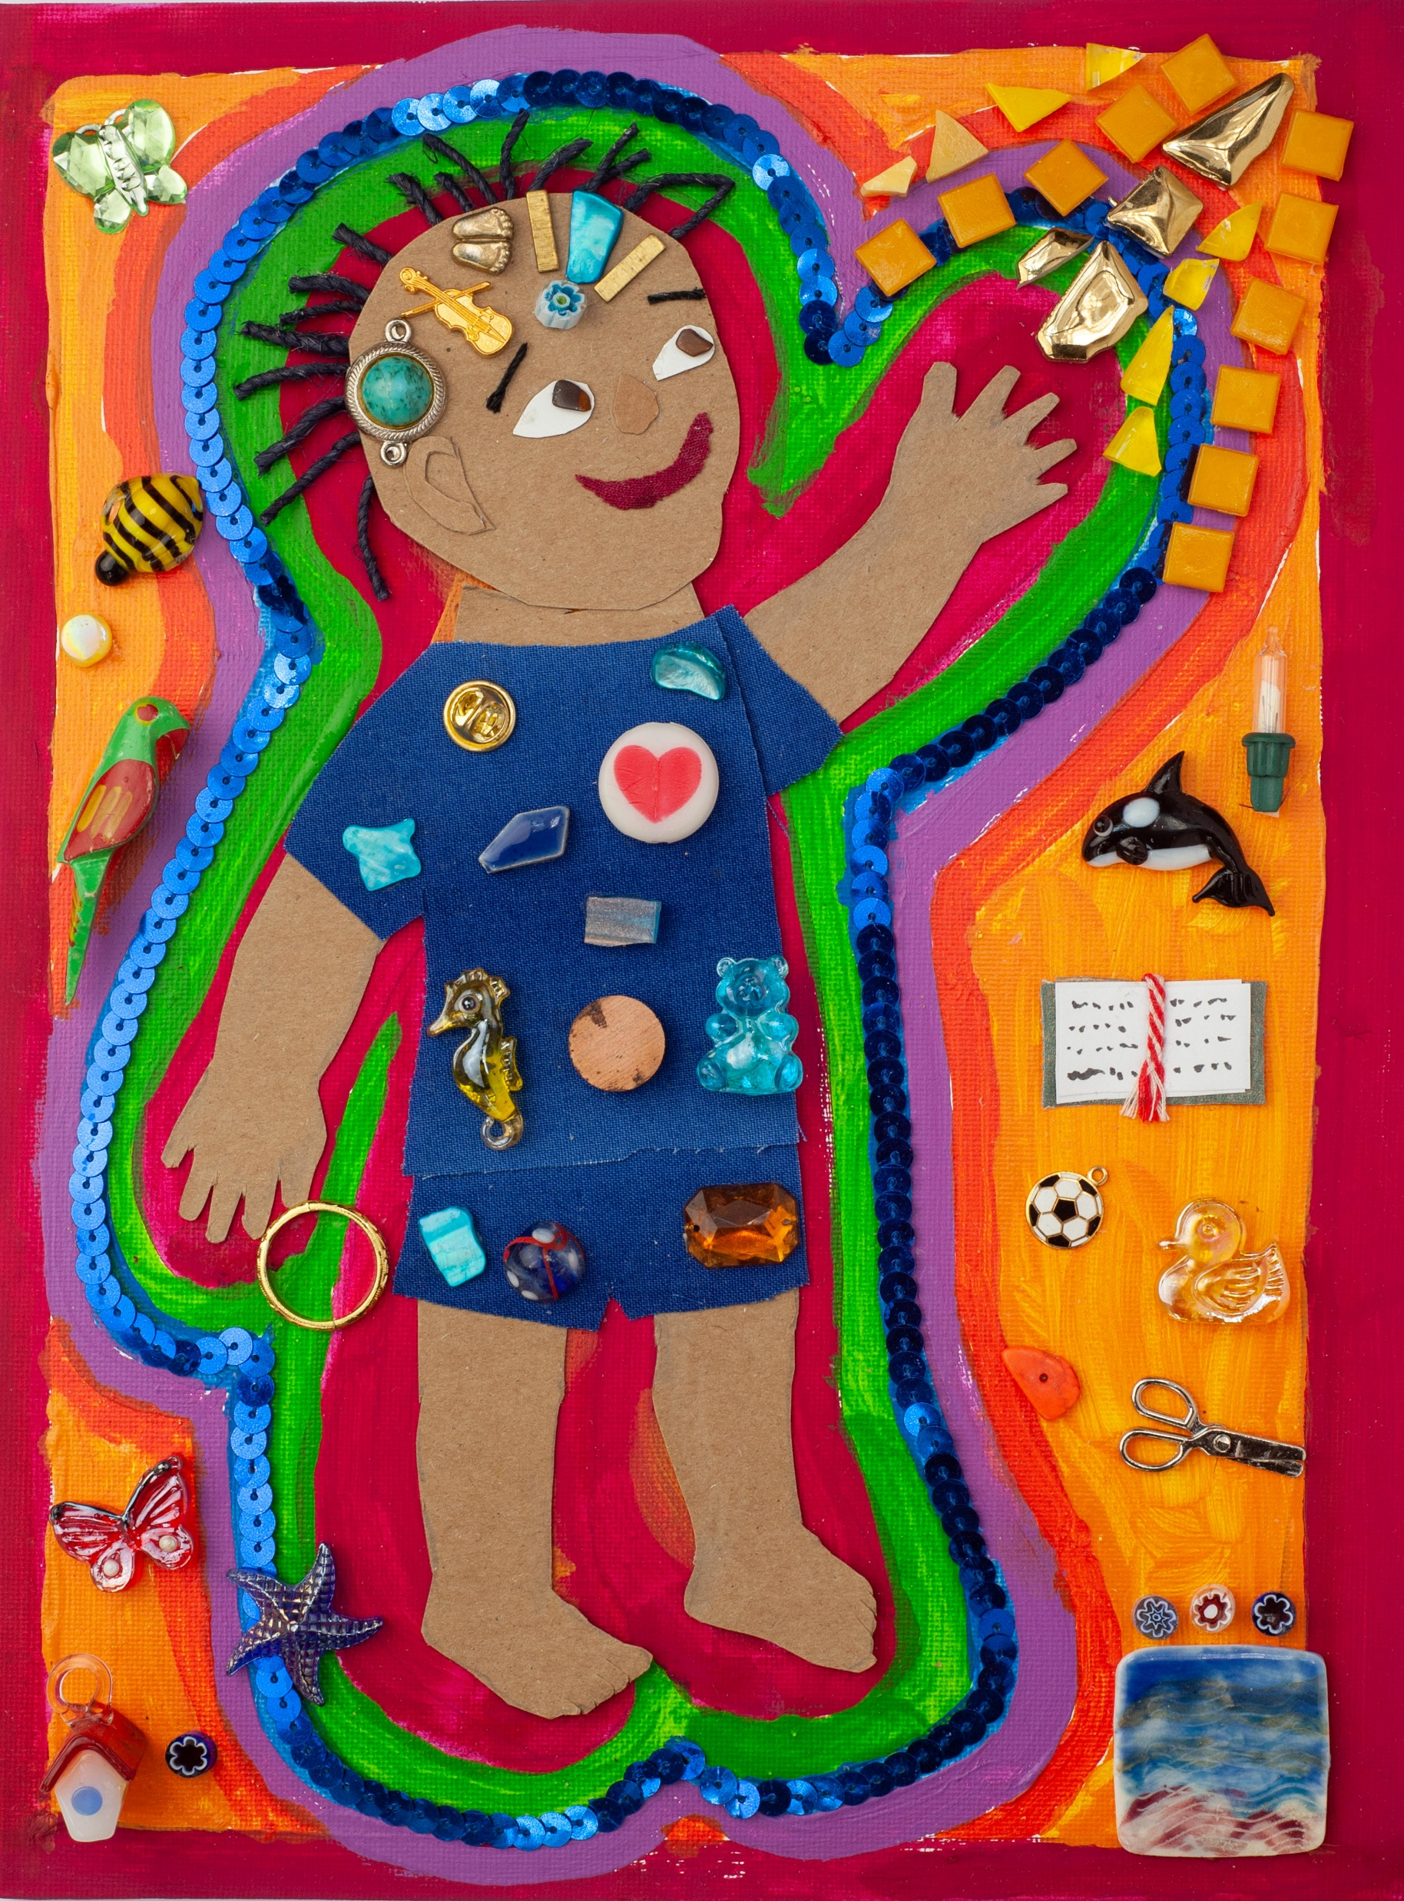
God formed you inside and out.
God knit you together in your mother’s womb.
You were made in a wonderful way.

Slide 3
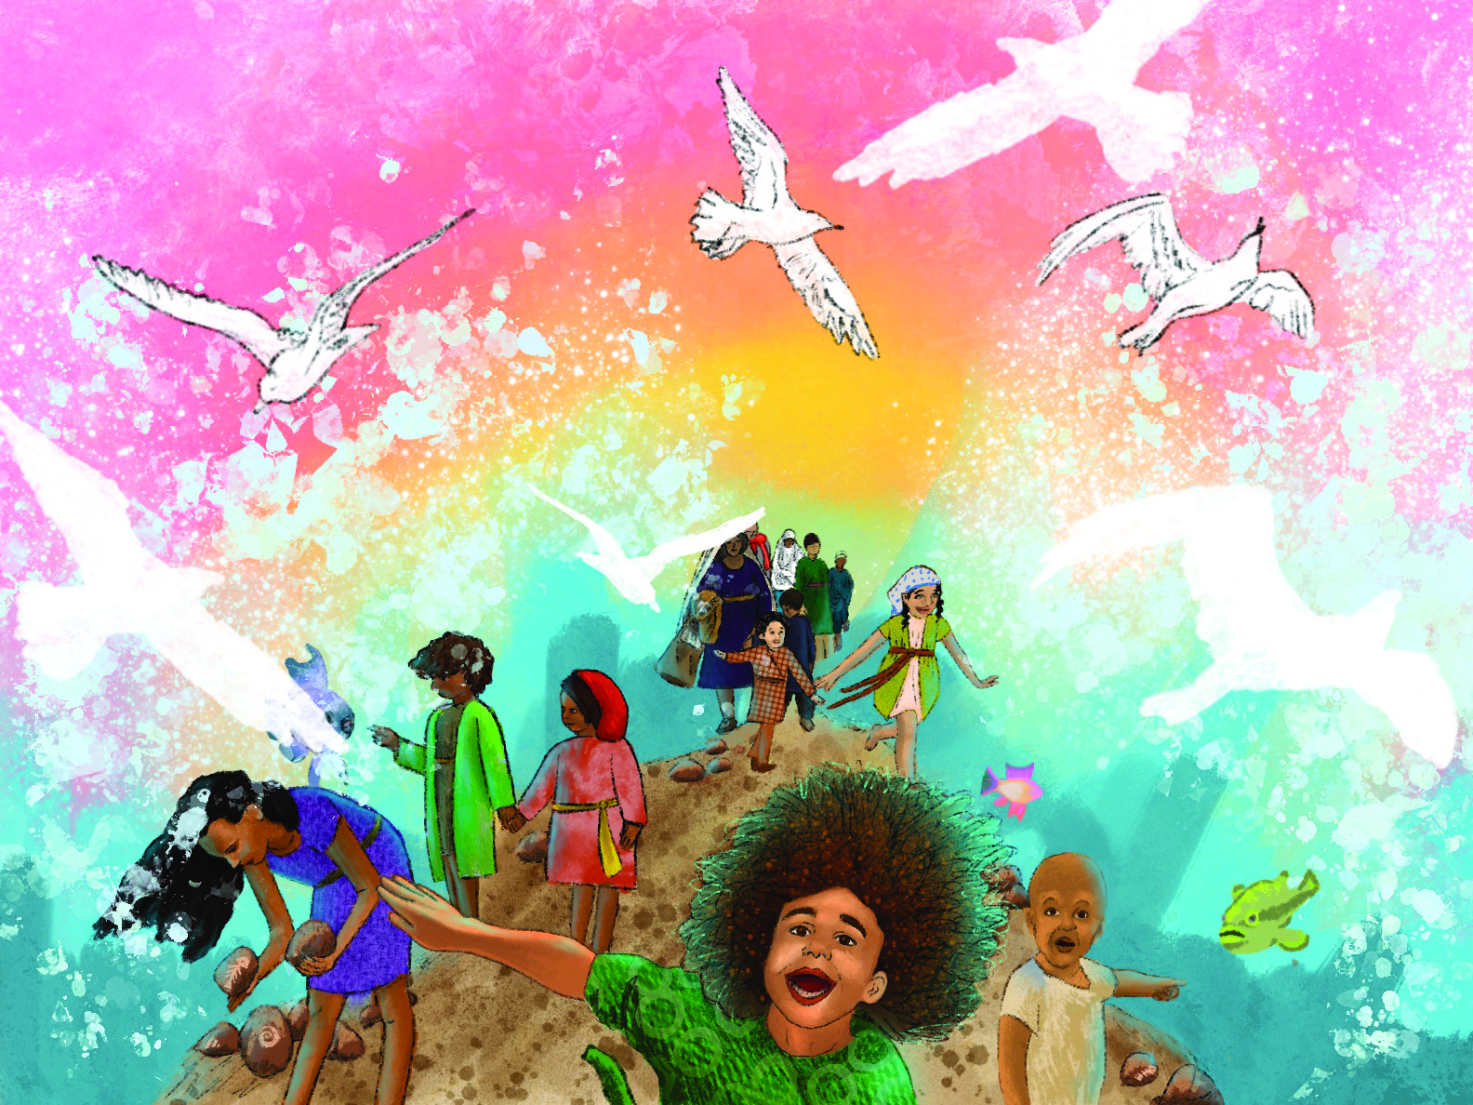
God has good plans for you.
God has loved you with an everlasting love and will always be faithful to you.

Slide 4
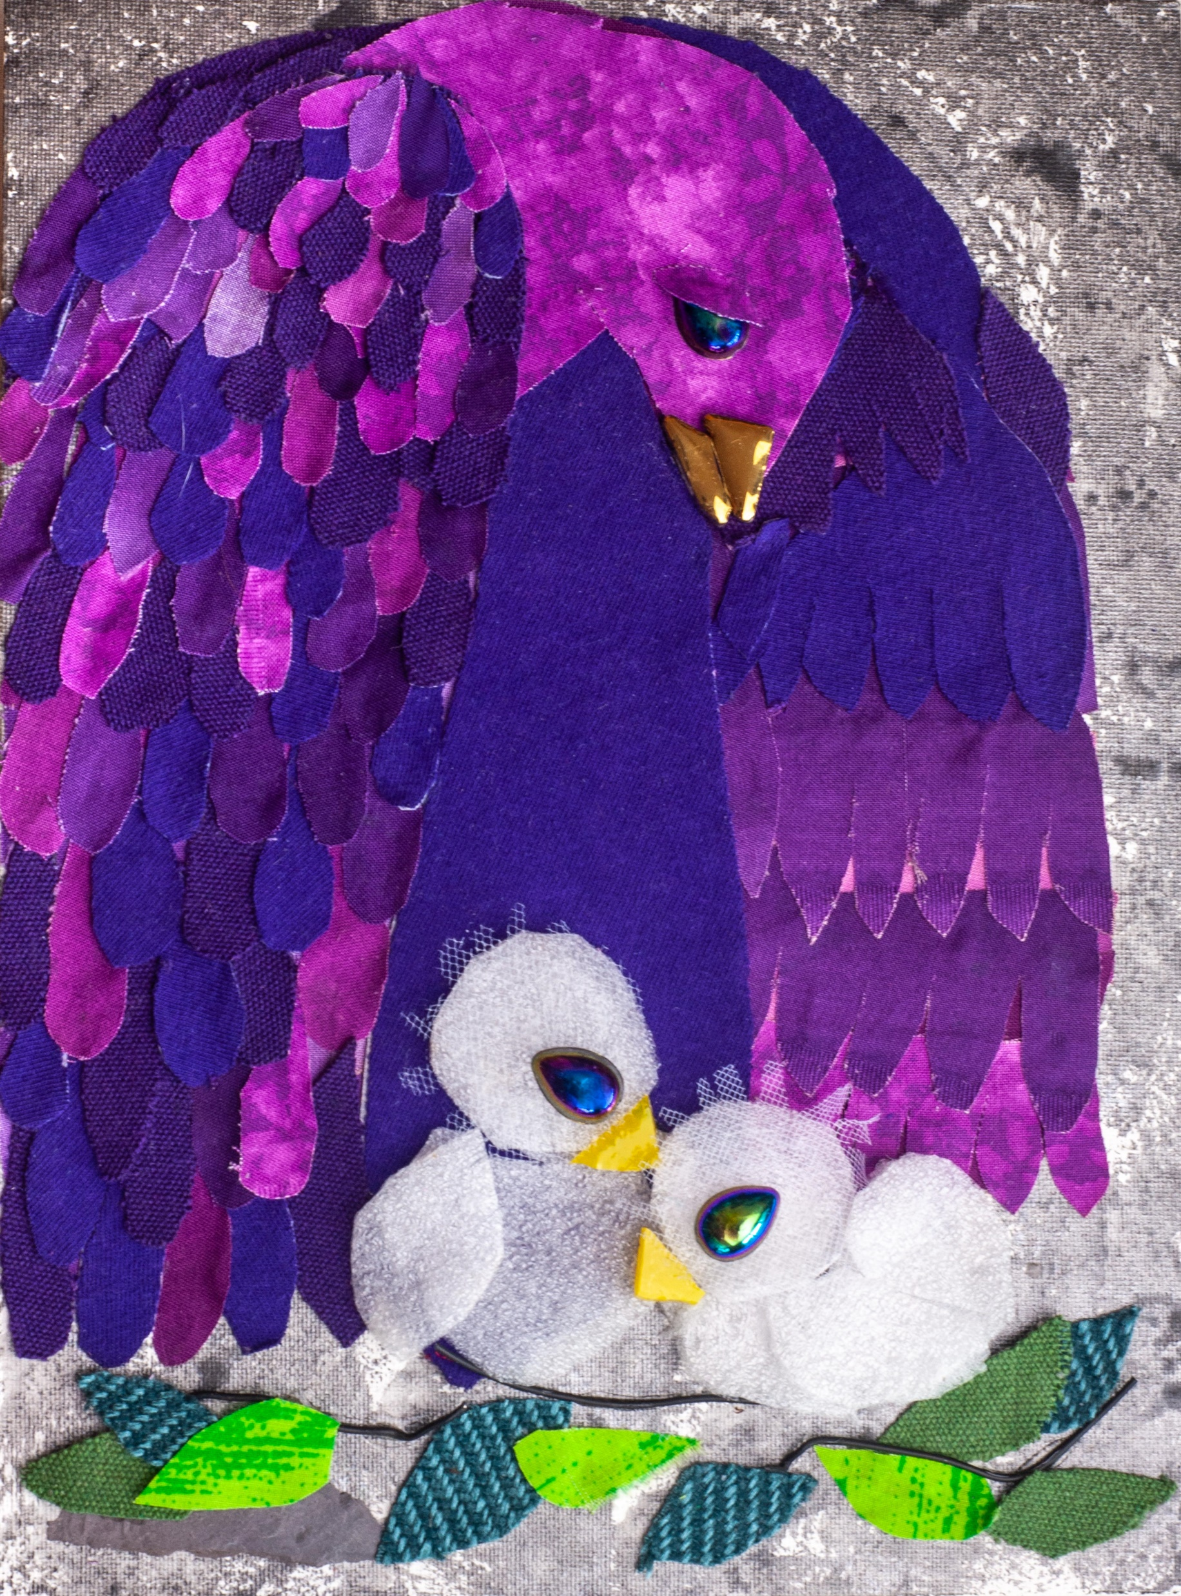
God will rescue
and protect you.
God will be with you
in trouble.

Slide 5
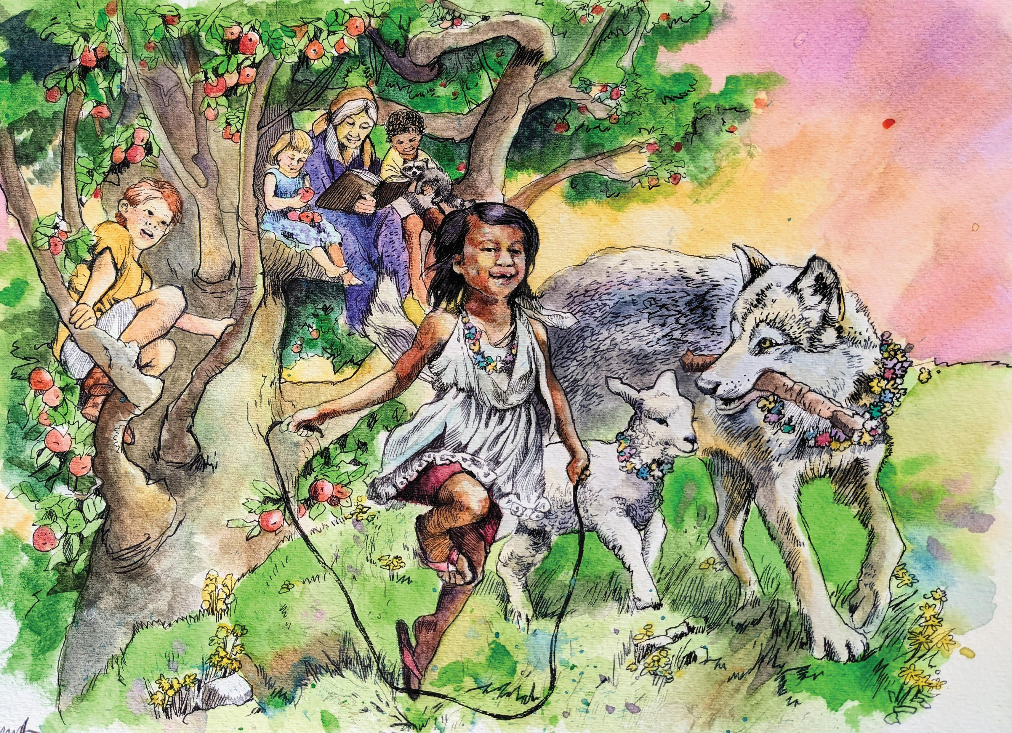
Rest in the great love God has for you. Let it bring joy to your heart.
God chose you and loves you.

Slide 6
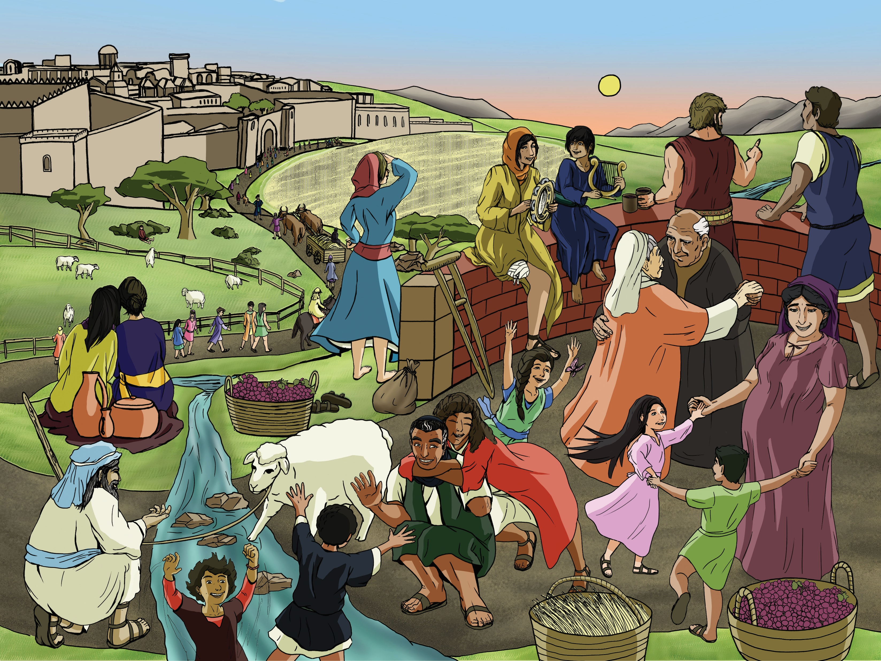
Song of Blessing

Slide 7
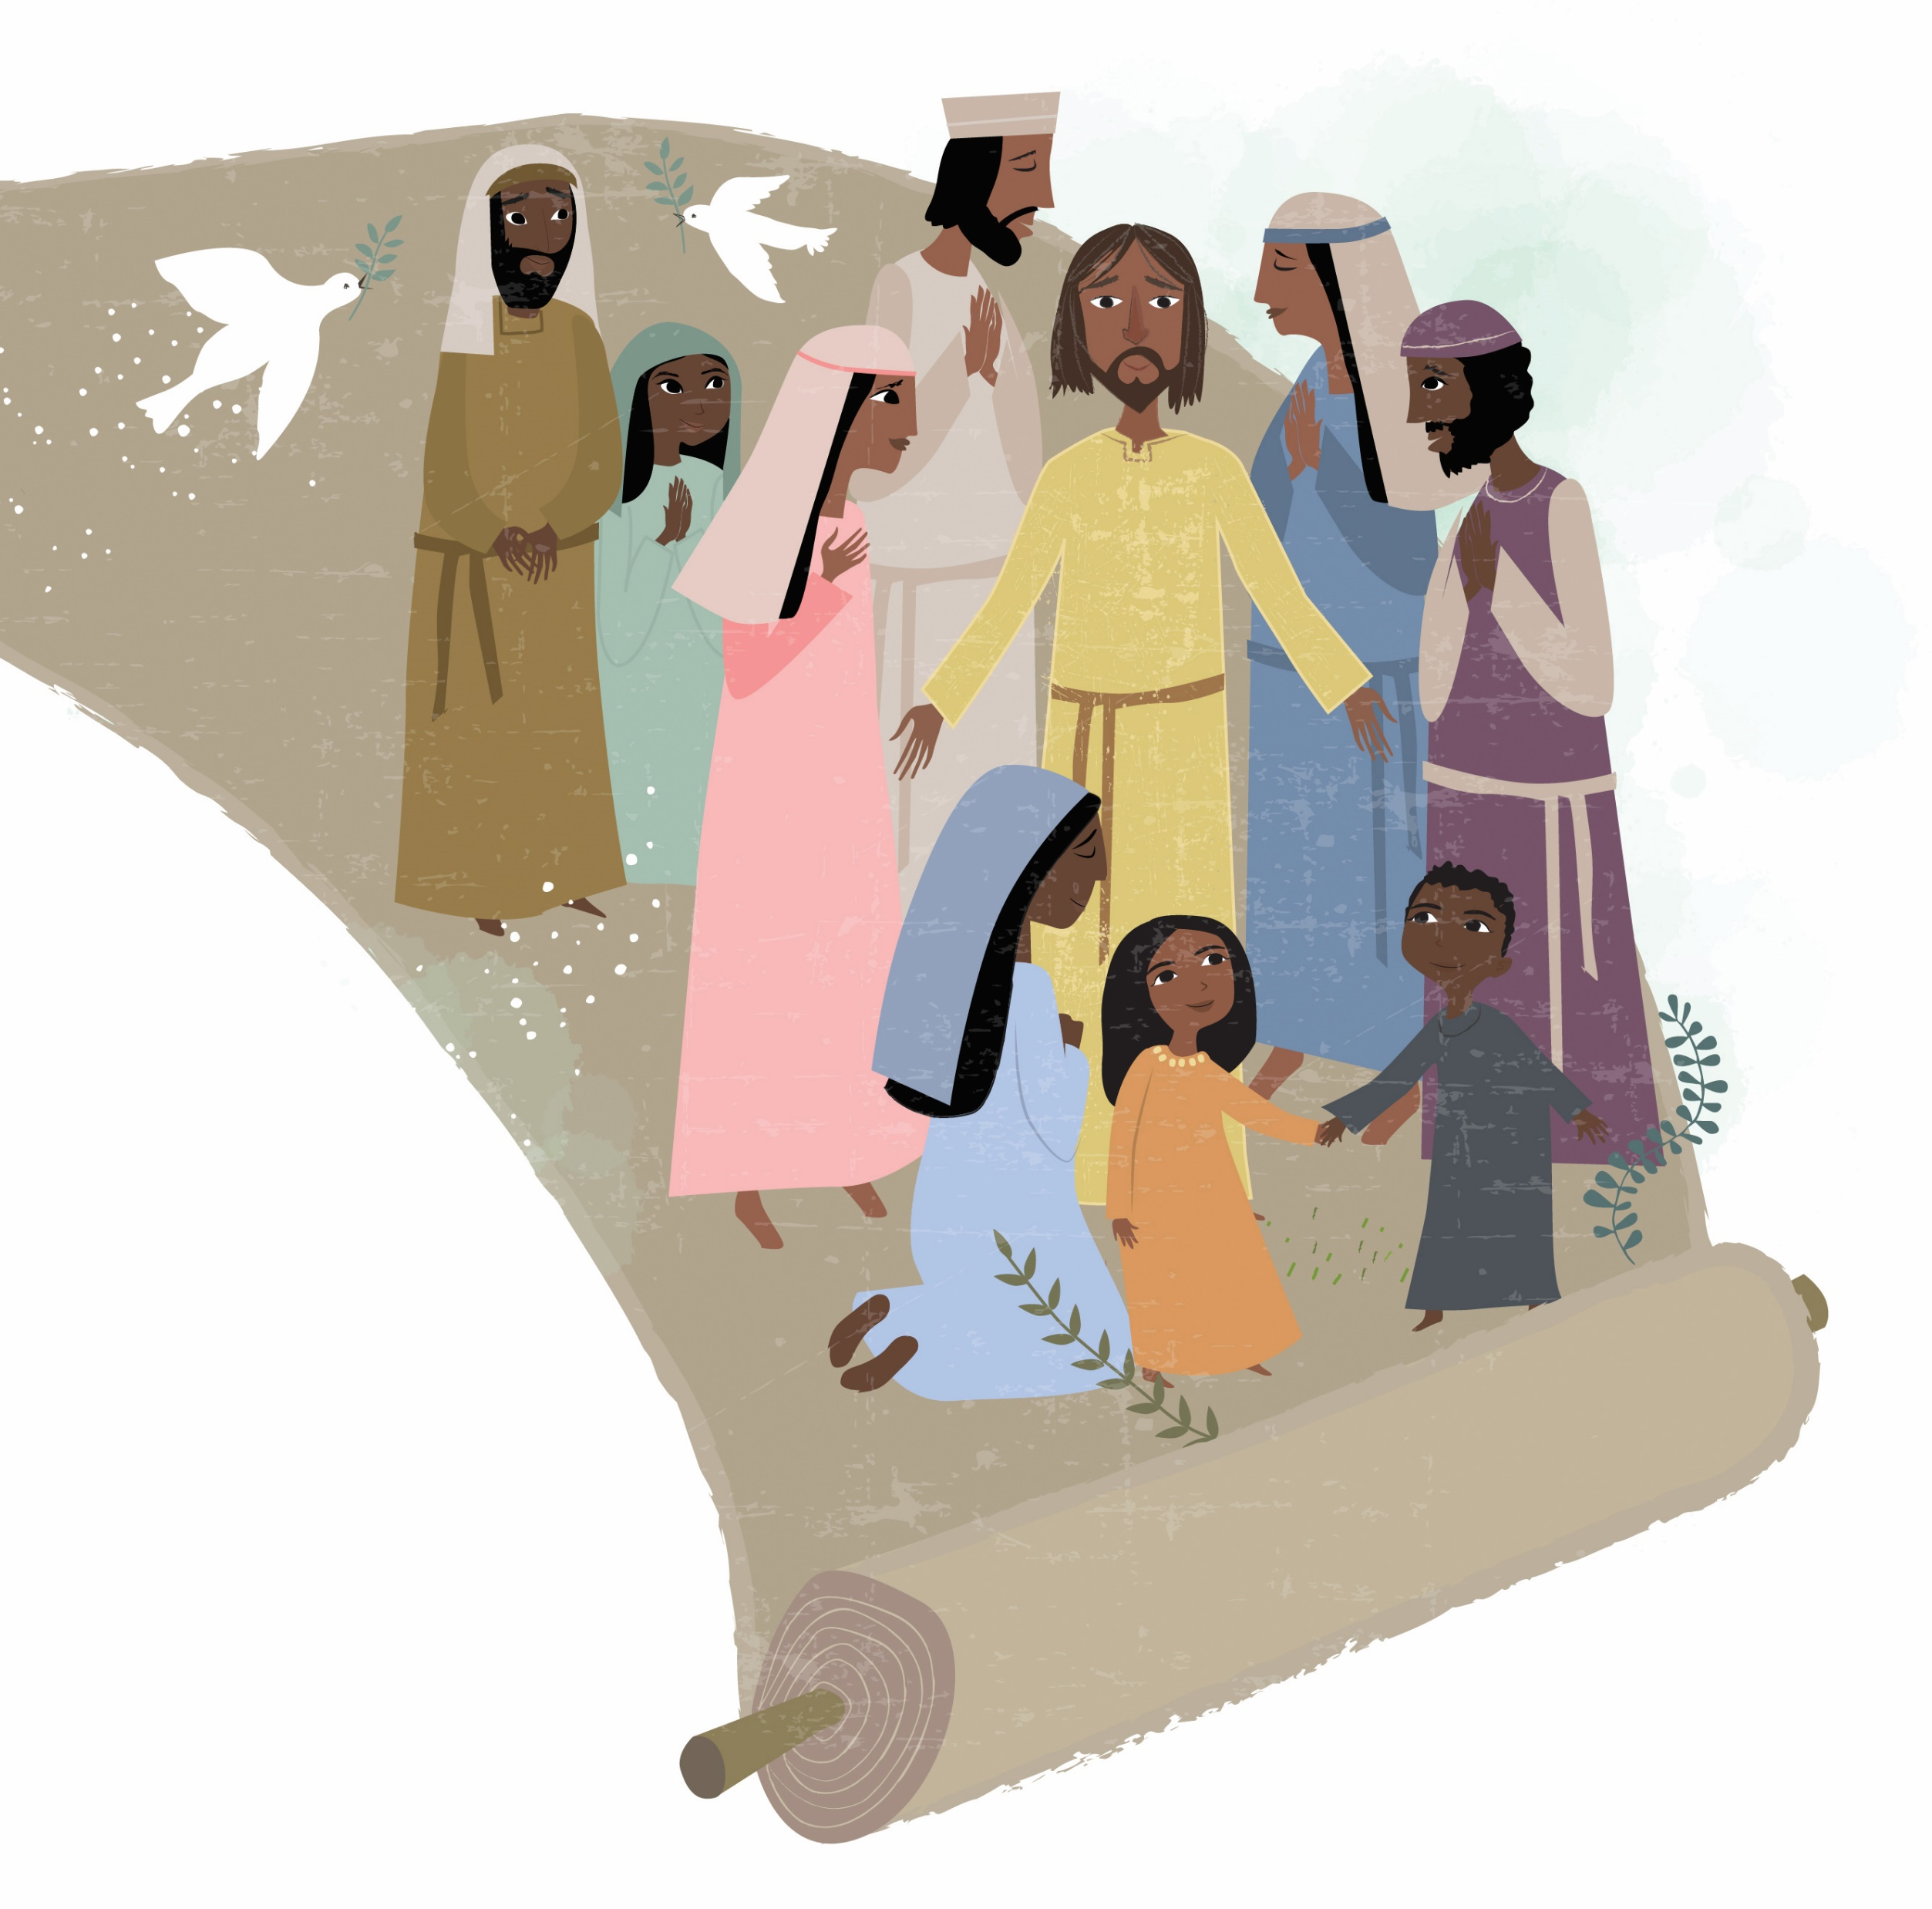
“May God Bless You”
May God bless you and keep you. May God’s face shine upon you. May God be gracious, and may God’s face turn toward you and give you peace.
Words and music: Seth Crissman and Greg Yoder (based on Numbers 6:24–26) © 2019 The Walking Roots Band. All rights reserved. Used with permission.

